Slide 1
Computer VISION
-Aayush Kubba

Slide 2
Agenda
In this session, you will learn about:
What is Computer Vision?
Tasks in CV
Working of Computer Vision
Applications

Slide 3

What is Computer Vision?

Slide 4
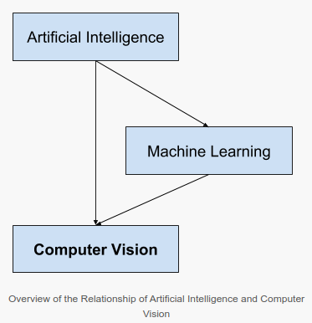
What is a Computer Vision?
Computer vision is a field of study focused on the problem of helping computers to see.
The goal is to use the observed image data to infer something about the world
It is called a subfield of artificial intelligence and machine learning
Which involves the use of specialized methods and make use of general learning algorithms

Slide 5
Problem solved by Computer Vision
Given a two-dimensional image, a Computer Vision System must recognize the present objects and their characteristics such as shapes, textures, colors, sizes, spatial arrangement, among other things so as to provide a description as complete as possible of the image.

Slide 6
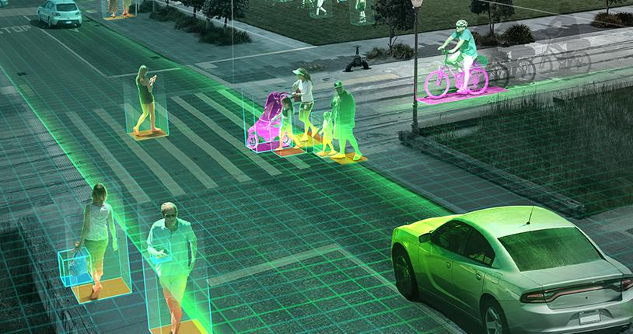
How does a Machine see?
Represent colors by numbers
Image Segmentation
Finding corners
Finding Textures
Make Prediction

Slide 7
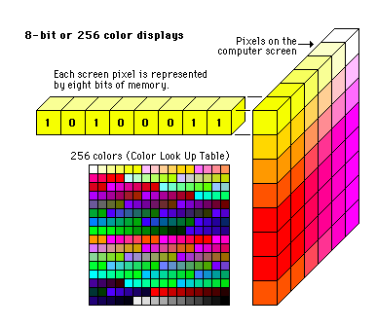
1. Represent colors by numbers
Recognizing an Image through Machine’s eyes
The machine performs the following operations :
In computer science, each color is represented by a specified HEX value.
That is how machines are programmed to understand what colors the image pixels are made up Whereas as humans we have an inherited knowledge to differ between the shades.

Slide 8
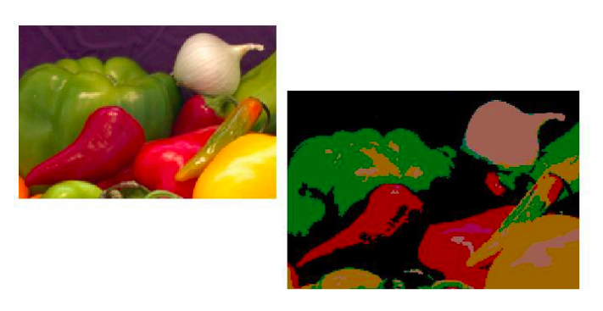
2. Image Segmentation
Recognizing an Image through Machine’s eyes
Computers are made to identify similar group of colors and then segment the image i.e. distinguish the foreground from background. The technique of color gradient is used to find edges of different objects.

Slide 9
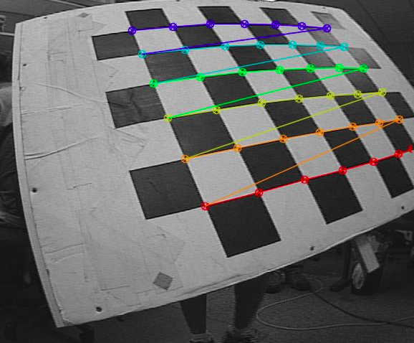
3. Finding corners
Recognizing an Image through Machine’s eyes
After segmentation, images are then looked up for certain features, also known as corners.
Algorithms search for lines that meet at an angle and cover a specific part of the image with one color shade.
Features, also called corners are the building blocks which help to find more detailed information contained in the image.

Slide 10
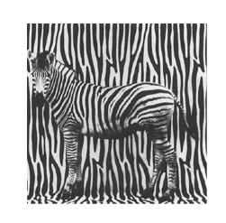
4. Finding textures
Recognizing an Image through Machine’s eyes
Another important aspect to identify any image correctly is to determine the texture in the image. The difference in textures between two objects makes it easier for a machine to correctly categorize an object.

Slide 11
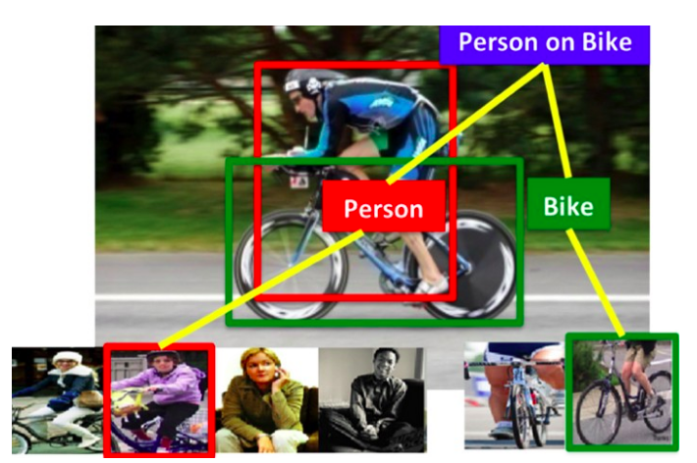
5. Make a prediction
Recognizing an Image through Machine’s eyes
After implementing the above steps, a machine needs to make a nearly-right guess and match the image with those present in the database.

Slide 12
6. Finally, see the bigger picture!
Recognising an Image through Machine’s eyes
At last, a machine sees the bigger and clear picture and checks if it was right identifying the one, as per the feeded algorithmic instructions.
The accuracy has improved a lot in past years but still, machines make mistakes when asked to handle images with mixed objects.

Slide 13
Tasks in CV

Slide 14
Typical tasks in Computer Vision
Computer vision is based on an extensive set of diverse tasks, combined to achieve highly sophisticated applications
Some tasks in Computer Vision are:
Image classification
Localization
Object detection
Object identification
Instance segmentation
Object tracking

Slide 15
Image Classification
Image classification networks start with an input of fixed size.
The input image can have three channels.
When you design your network, the resolution can technically be any size as long as it is large enough to support the amount of downsampling you will do throughout the network.
For example, if downsampling is 4 times within the network, then input needs to at least be 4² = 16 x 16 pixels in size.
The spatial resolution decreases as we go deeper into the network.

Slide 16
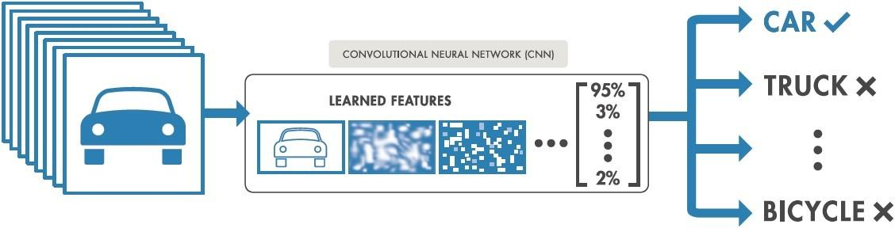
Image Classification
This occurs as we try to squeeze all of that information and get down to a 1-dimensional vector representation.
After a certain amount of downsampling that you have selected, the feature maps are vectorized and fed into a series of fully connected layers.
The last layer has as many outputs as there are classes in your dataset.

Slide 17
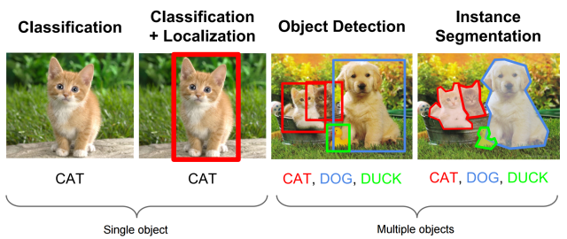
Localization
Localization is an extension of classification
In localization we not only classify the images but are also interested in knowing exactly where they are
The goal of localization is to find the location of a single object in an image. For example, in the image below, the cat has been localized.

Slide 18
Localization
The standard way to perform localization is to define a bounding box enclosing the object in the image
Localization is a particularly useful task
It can allow for the automatic cropping of objects in a set of images
For instance, if it is combined with the classification task, it could allow us to quickly build a dataset of (cropped) images of famous tourist attractions.

Slide 19
Object Detection
The purpose of object detection is to find and then classify a variable number of objects in an image
Object detectors come in 2 flavors: one-stage and two-stage
Both of them start out with “anchor boxes” which are these are default bounding boxes
Our detector is going to predict the difference between those boxes and the ground-truth, rather than predicting the boxes directly

Slide 20

What is Object Detection?
Object detection is a computer vision technique that allows us to identify and locate objects in an image or video.
With this kind of identification and localization, object detection can be used to count objects in a scene and determine and track their precise locations, all while accurately labeling them.

Slide 21
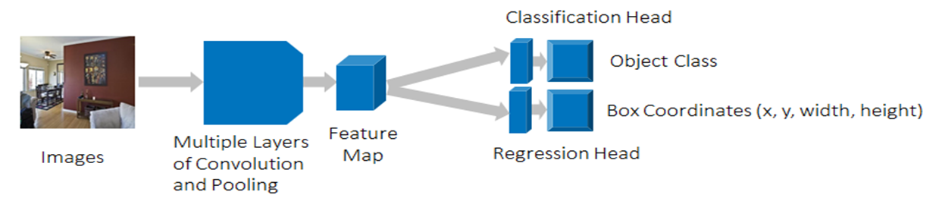
How object Detection works
An encoder takes an image as input and runs it through a series of blocks and layers that learn to extract statistical features used to locate and label objects.
Outputs from the encoder are then passed to a decoder, which predicts bounding boxes and labels for each object.

Slide 22
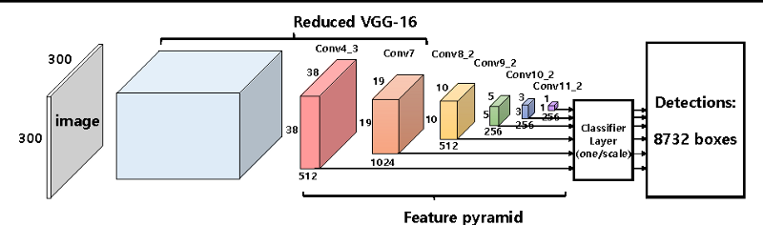
One-stage Detector
The proposal and classifier networks are fused into one single stage
The network directly predicts both the bounding box coordinates and the class which resides within that box
One-stage detectors have high speed because two stages are fused together

Slide 23
Two-stage Detector
Here we have two networks: a box proposal network and a classification network
The box proposal network proposes coordinates for bounding boxes where it thinks there is a high likelihood that objects are there; again these are relative to the anchor boxes.
The classification network then takes each of these bounding boxes and classifies the potential object that lies within it.

Slide 24
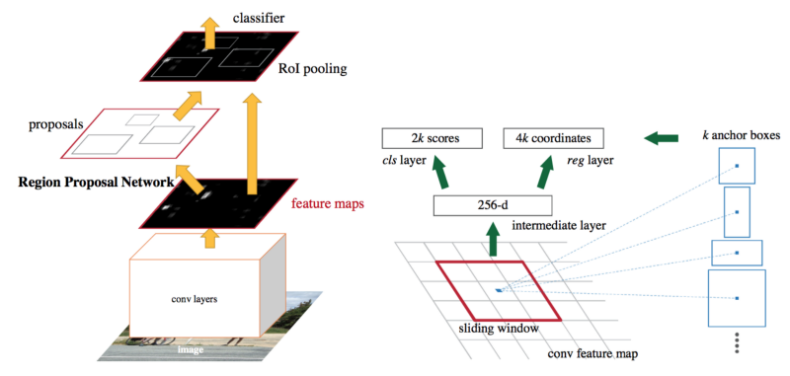
Two-stage Detector
Two-stage detectors
The two-stage detectors have higher accuracy due to the separation of the two tasks
But they are slower than one stage detector

Slide 25
Object Identification
Object identification is slightly different from object detection, although similar techniques are often used to achieve both of them
The goal is to find instances of said object in images
It is not about classifying an image but about determining if the object appears in an image or not, and if it does appears, then specifying the location(s) where it appears
An example is monitoring real time images from security cameras to identify a specific person’s face

Slide 26
Segmentation
In Segmentation the networks need to learn both low and high-level information
Low-level information to accurately segment each area and object in the image by the pixel
High-level information to directly classify those pixels
This leads to networks being designed to combine the information from earlier layers and high-resolution (low-level spatial information) with deeper layers and low-resolution (high-level semantic information)

Slide 27
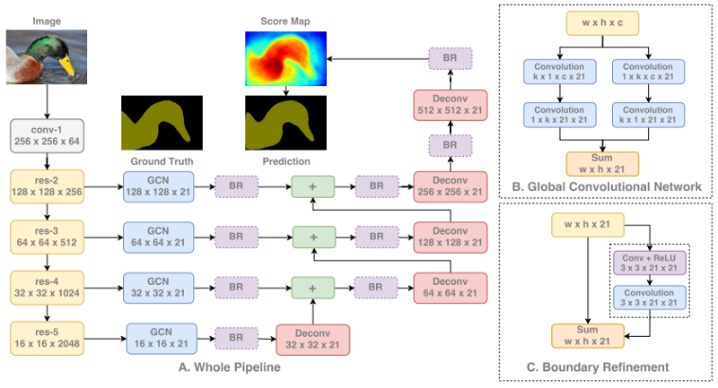
Segmentation
As we can see below, we first run our image through a standard classification network
Then extract features from each stage of the network using information from a range of low-to-high
Each information level is processed independently before combining
As the information is combined, we upsample the feature maps to eventually get to the full image resolution

Slide 28
Object Tracking
The purpose of object tracking is to track an object that is in motion over time
It utilizes consecutive video frames as the input
It is equally crucial for autonomous vehicles to allow for high-level spatial reasoning and path planning
Similarly, it is useful in various human tracking systems, from those which try to understand customer behavior to those which constantly monitor football or basketball players during a game

Slide 29
How to perform Object Tracking?
A way to perform object tracking is to apply object detection to each image in a video sequence
Then compare the instances of each object to determine how they moved
The drawback of this approach is that performing object detection for each individual image is typically expensive
An object tracking method does not necessarily need to be capable of detecting objects
It can simply be based on motion criteria, without being aware that the object is being tracked

Slide 30
Working of Computer Vision

Slide 31
Steps to building a CV model using CNNs
Creation
Extraction
Train the model
Test the model
Create a dataset comprised of annotated images or use an existing one.
Extract, from each image, features pertinent to the task at hand
Train a deep learning model based on the features isolated
Evaluate the model using images that weren’t used in the training phase
1
2
3
4

Slide 32
Steps to building a CV model using CNNs
Creation
Create a dataset comprised of annotated images or use an existing one
Annotations can be the image category (for a classification), pairs of bounding boxes and classes (for object detection), or a pixel-wise segmentation of each object of interest present in an image (for segmentation)
Extract
Extract, from each image, features pertinent to the task at hand
This is a key point in modeling the problem
For example, features based on facial criteria, are obviously not the same as those used to recognize tourist attractions or human organs

Slide 33
Steps to building a CV model using CNNs
Train the model
Train a deep learning model based on the features isolated
Training means feeding the machine learning model many images and it will learn, based on those features, how to solve the task at hand
Test the model
Evaluate the model using images that weren’t used in the training phase
By doing so, the accuracy of the training model can be tested

Slide 34
Applications

Slide 35
Industry Applications
Retail
Behavioral tracking
Inventory Management
Manufacturing
Healthcare
Autonomous vehicles
Insurance
Agriculture
Defense and Security

Slide 36
Business Use Cases
Visual Search Engines
Face recognition at Facebook
Amazon Go
Tesla Autopilot
Microsoft InnerEye

Slide 37
Challenge of Computer Vision
Computer vision remains unsolved, at least in terms of meeting the capabilities of human vision
Reasons which make CV challenging
We don’t have a strong grasp of how human vision works
The complexity inherent in the visual world
A true vision system must be able to “see” in any of an infinite number of scenes and still extract something meaningful.
Computers work well for tightly constrained problems, not open unbounded problems like visual perception.

